Slide 1

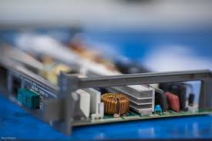


POWER SOURCES & POWER PROTECTION
SUBMITTED BY: GROUP-A
Submitted to-
Sanket Timsina
SUBMITTED BY-
GROUP - A
8-1-2025

Slide 2


POWER SOURCE
Definition :
A power source is any system or device that provides electricity to operate electrical equipment.

Slide 3

Types Of Power Sources
Alternating Current (AC)
Supplied by utility companies
Powers homes, schools, and industries
Direct Current (DC)
Provided by batteries and solar panels
Used in smartphones, laptops, and electronic circuits
Renewable Sources
Solar, wind, hydro
Eco-friendly and sustainable
POWER SOURCES
Backup Power Sources
UPS (Uninterruptible Power Supply)
Generators
Inverters

Slide 4

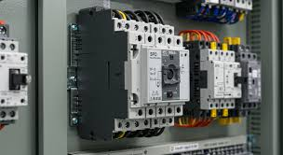
WHAT IS A POWER SURGE?
Definition :
A power surge is a brief spike in voltage above the normal range.
Surges can rise to thousands of volts and last milliseconds.

Slide 5
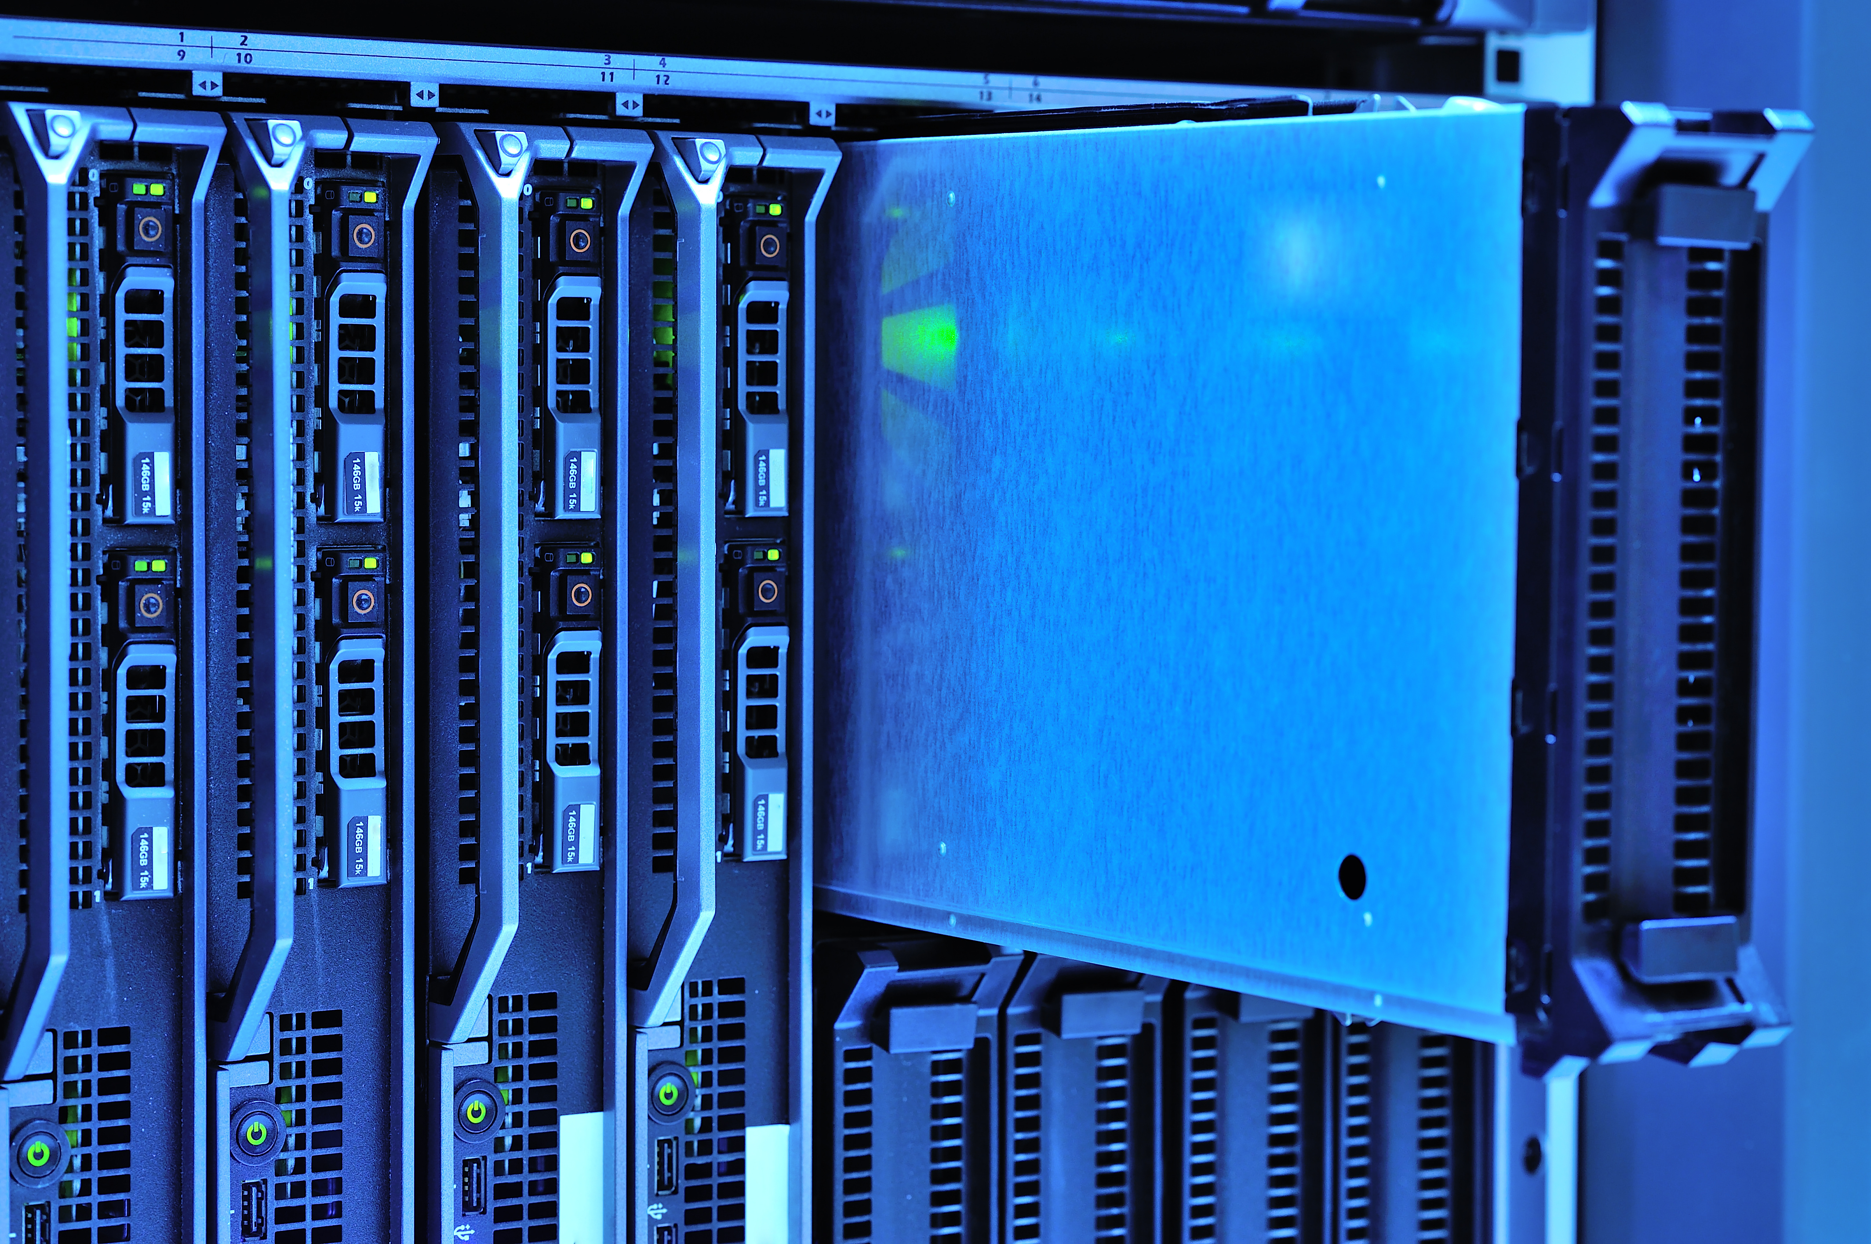

Introduction to Surge Suppressors
Definition :
A surge suppressor is a device that protects electrical equipment by diverting or blocking excess voltage caused by surges.
Installed between the power source and the device.
Allows only safe voltage to pass through.

Slide 6

How Does a Surge Suppressor Work?
During a surge:
It quickly diverts extra voltage to the ground wire.
This prevents the surge from reaching connected devices.
Contains a Metal Oxide Varistor (MOV).
Under normal voltage, the MOV does nothing.

Slide 7
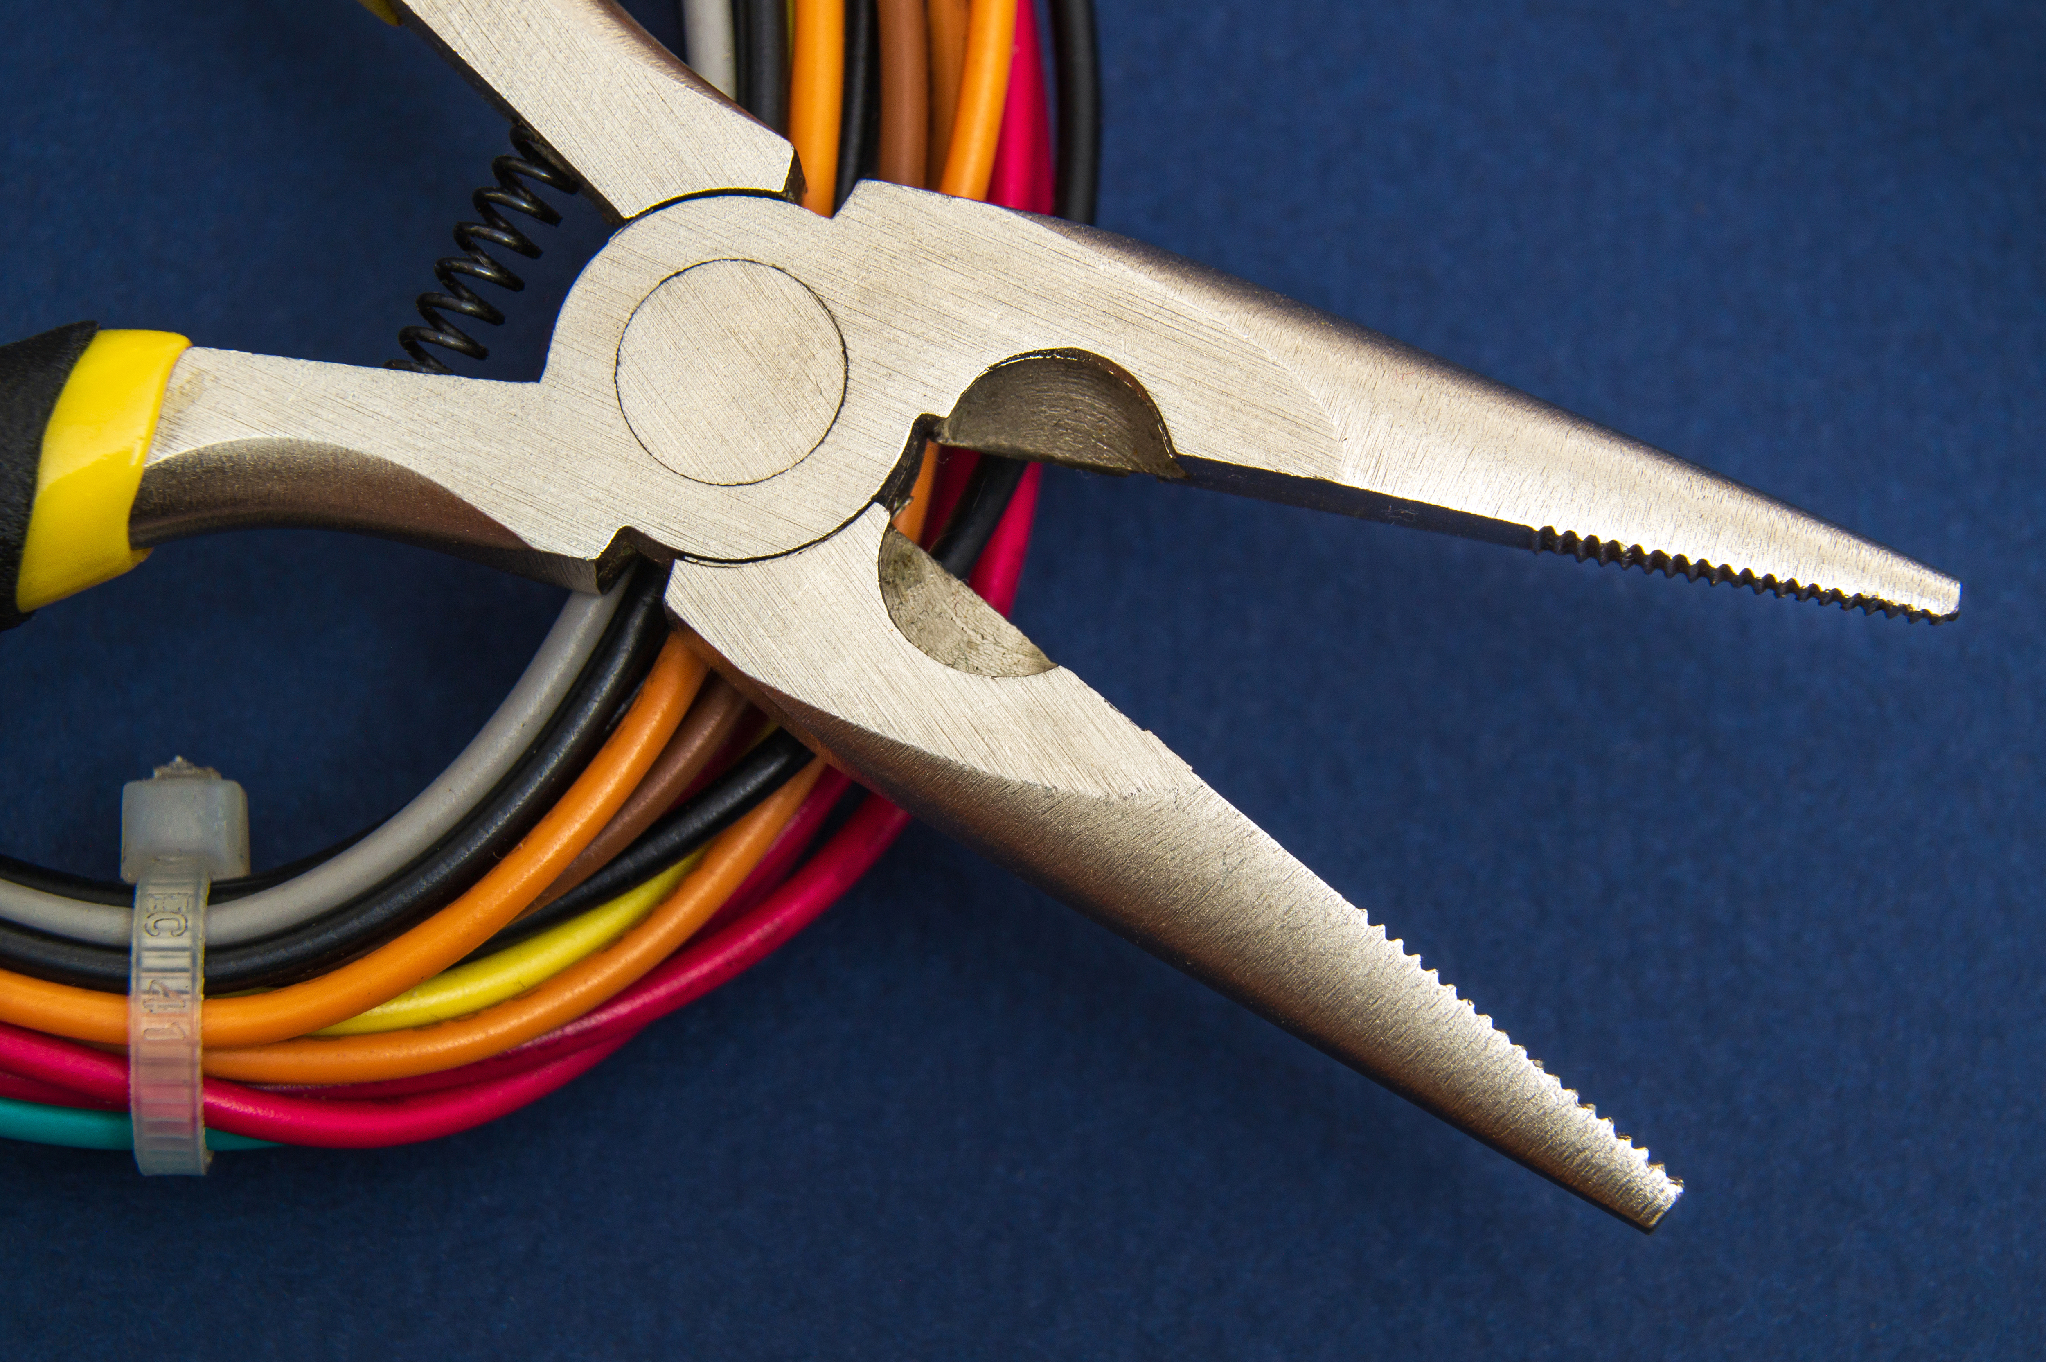
IMPORTANCE
Equipment Protection
Increased Lifespan of Electronics
Fire and Hazard Prevention
Prevents permanent damage to expensive devices like TVs, computers, routers, and appliances.
Reduces wear and tear caused by frequent minor voltage spikes.
Avoids overheating and electrical fires caused by power surges.

Slide 8

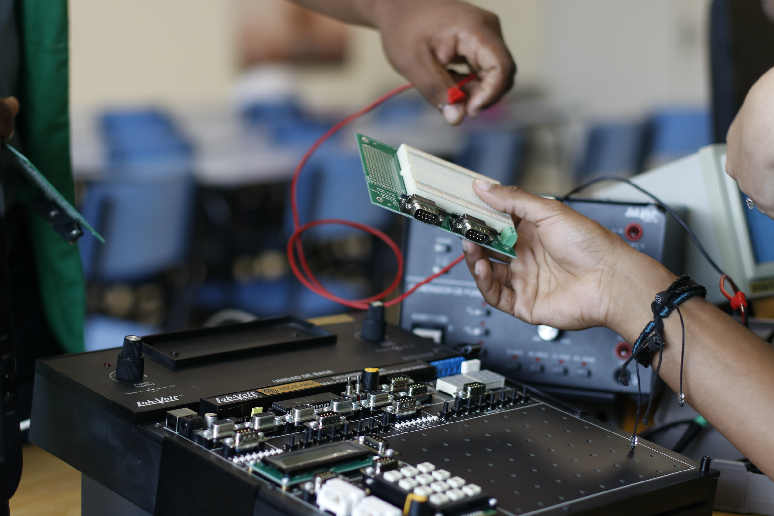
CONCLUSION
POWER SURGES ARE A SERIOUS RISK TO ELECTRONIC DEVICES, OFTEN CAUSING DAMAGE OR DATA LOSS. SURGE SUPPRESSORS PROVIDE ESSENTIAL PROTECTION BY SAFELY BLOCKING EXCESS VOLTAGE. THEY HELP EXTEND DEVICE LIFESPAN, REDUCE REPAIR COSTS, AND ENSURE ELECTRICAL SAFETY.

